Slide 1
TechWise Team 4 Project 1
Project Update Week 5 August 10, 2022

Slide 2
Project Team Members
Dennis Bowen – Frontend/Backend
Viktoria Denys - Backend
James Rodgers- Backend
Alan Snyder – Frontend/Backend
Jackson Trainer – Frontend/Backend

Slide 3
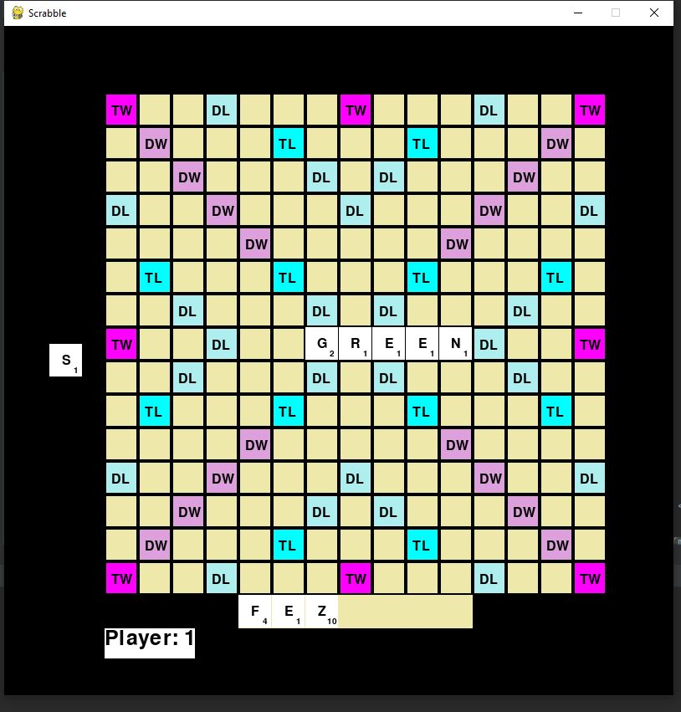
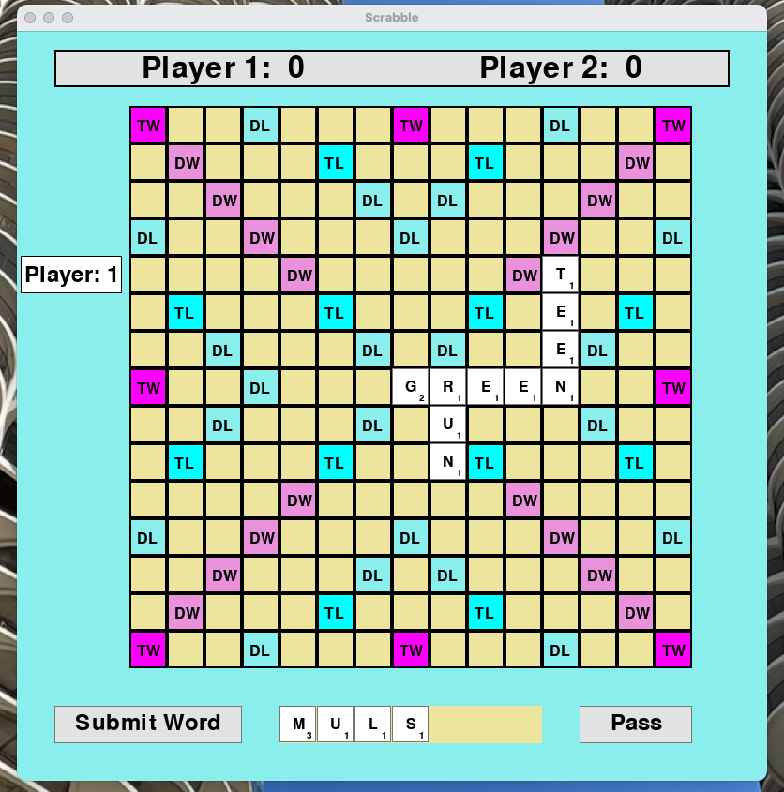
In Process Screenshots
Previous Version
Current Version

Slide 4
Project Status
Completed
Draw tile feature, place a tile from the tray, added text to board, updated tile visuals to include tile points and center font, and basic player mechanics including skipping a turn.
In process
Score Calculation, reorder tiles in the tray, discard tiles, improve on-screen buttons (submit, pass, discard), and display player scores
Known Bugs
Place multiple tiles in a single spot on the board
Tiles placed on last column crashes program
Notes:
James

Slide 5
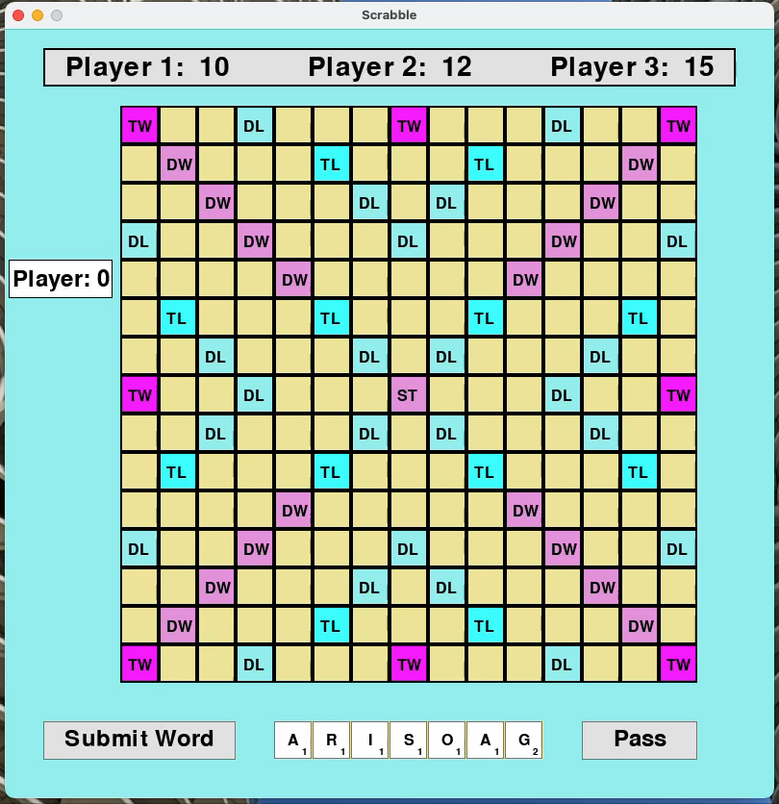
Demo
Notes:
Alan

Slide 6
Challenges
Making the font move with the tile image on the board
Infinite player loop
Working with a grid system and the math needed when using the mouse
Tile alignment to the space on the board
Notes:
Vic

Slide 7
Lessons Learned
Continuing to learn PyGame and how to render text and rectangle objects
Using objects in Python and how to pass objects
Working with mouse events in PyGame
Game loops with multiple loops
Notes:
Denis

Slide 8
Project Timeline
Project Kickoff
Week 1
Completed initial pseudocode
Week 2
Week 3
Week 4 - Planned Work
Week 5
Week 6
Multiple functions related to tile placement and interaction
Created Player, Tile, Tile Bag, Controller objects
Game board designed with basic features
Display tiles on the game board
Scoring logic
Discard tiles
Improve on-screen buttons (submit, pass, discard)
Notes:
Jackosn

